Slide 1

Why do I need Git/GitHub??

Slide 2
Version Control with Git/GitHub
Instructor: Gerardo Hidalgo-Cuellar
Website: www.rc.colorado.edu
Helpdesk: rc-help@colorado.edu
Slides: https://github.com/ResearchComputing/New_User_Seminar
Survey: http://tinyurl.com/curc-survey18

Slide 3
RMACC Cyber Infrastructure Portal
https://ask.cyberinfrastructure.org/c/rmacc/65
This forum provides opportunity for RMACC members to converse amongst themselves and with the larger, global research computing community.
The “go to” general Q&A platform for the global research computing community - researchers, facilitators, research software engineers, CI engineers, sys admins and others.

Slide 4


My Goal
Learning Goals
Convince you that Git/GitHub fluency is:
Easy!
Practical (as a researcher!)
An important (if not the most important!) tool in your tool belt*!
Understand basics of version control
Differences between Git, GitHub
Basic Git fluency
How to collaborate on a project with Git
*I may be biased
images: wikipedia

Slide 5
Outline
Setting started with Git (Locally)
Getting started with GitHub (Remote)
Collaboration
Advanced Topics (if time allows)

Slide 6
GitHub Account Check
Create a free account at: https://github.com/signup
Necessary for the GitHub portion of the class

Slide 7
Getting Started with Git
(local)

Slide 8
You may know about GitHub!
Thumbs up if you have visited a GitHub project before?
What kinds of things have you used GitHub for?
Git and GitHub are different, and we’ll get into that!

Slide 9
What is version control?
Why do I need version control as a researcher? Isn’t it for developers?
NO! Version control systems let you track changes you make to your files over time.
Revert to various states of files
Test things out without harming originals
Not limited to source code
test files, images, etc…

Slide 10


What is version control?
Think Google Drive with jet engines!
You have direct control over:
history
paths (alternate universe)
merging new changes into projects
Main
Images: wikicommons, nobledesktop.com

Slide 11


Different Version Control Systems
Subversion (svn)
Mercurial
CVS
etx…
We’re going to stick to Git
industry standard
widely known
most resources
Images from Wikipedia

Slide 12
Git vs GitHub
Git: version control system (installed locally)
the actual software
GitHub: Cloud-based storage (repository, or “repo”) site
a common/shared area to host projects
many Git features as a web GUI

Slide 13
Setting Git up locally
Many systems already have Git installed
check in a terminal with: git --version
if you don’t have it, you’ll need to install it a the main Git website: https://git-scm.com/downloads
You can follow along on your computer if you have git installed, or log into the RC system which has Git already installed.

Slide 14
Logging into RC via Terminal
To login to an RC login node:
$ ssh <username>@login.rc.colorado.edu
Supply your IdentiKey password and your Duo app will alert you to confirm the login
If you’re using a tutorial account (we provide password):
$ ssh <tutorial_user>@tlogin1.rc.colorado.edu

Slide 15
Configure Git
configuration variables (like env) for Git
$ git config --list
Let’s set up our name and emails
$ git config --global user.name “Jane Smith”
$ git config --global user.email “jane@email.com”

Slide 16
Hands on tutorial
We are going to create a simple HPC project that run a simple “hello world” python program with 5 different cores
Following the loadbalancer example at: https://curc.readthedocs.io/en/latest/software/loadbalancer.html
What do we need?
hello world python script
loadbalancer command file
slurm script

Slide 17
Project Directory
First lets create a new directory for our project:
$ cd /projects/$USER # or wherever
$ mkdir git-tutorial
$ cd git-tutotial

Slide 18
Git Repository (Repo)
A Git repo is a set of files that keep track of changes within a directory (folder)
We need to tell Git to actually set this up

Slide 19
Create a file
Now let’s create the first file for our project, the python “hello_world.py” script.
Keep it simple for now:
use your favorite text editor (vi/vim, nano, emacs) to create it:
$ vim hello_world.py
Enter the following line into the file, save and exit
print(“Hello, World!”)

Slide 20
Git Init
Git init will initialize a directory as a Git project:
$ git init
This will tell Git to get ready to start watching your files for every change that occurs.
What's actually happening here?
The Git program has created a "hidden" directory called .git
$ ls -a
This is where the “magic” happens!
Project history and other Git configs get stored here
Can also remote this directory to remove Git from project

Slide 21
An aside: Main vs. Master
Default is changing from Master -> Main as default branch or “trunk”
shorter
translates better into other languages
inclusive and recognizes issues with “master” language
now default
We’ll talk about branches later, but it’s easiest at this point to rename your default branch with:
$ git branch -M main

Slide 22
Git Status
The git status command displays the state of the working directory and the staging area.
$ git status
It lets you see which changes have been staged, which haven't, and which files aren't being tracked by Git.
Working Directory
hello_world.py
Staging Area
Repository

Slide 23
Git Ignore
You may have some files that you don’t want tracked
secret keys (passwords, API tokens, etc)
build files
data sets
Create a ignore.txt file
$ echo “ignore this file!” > ignore.txt
Create a .gitignore file
$ vim .gitignore
list any files/directories you don’t want tracked:
ignore.txt

Slide 24
Git Ignore (RC use case)
In you .gitignore you can choose to ignore output files:
*out # globbing, will get all files that end with “out”

Slide 25
Git Add
The git add command adds a change in the working directory to the staging area (getting the “picture” ready for a snapshot)
It tells Git that you want to include updates to a particular file.
$ git add hello_world.py # “git add .” to add all files
$ git status
**git add doesn't affect the repository - changes are not actually recorded until you run git commit
Working Directory
hello_world.py
Staging Area
Repository
git add

Slide 26
Your Git timeline
Git commits are like savepoints or snapshots of your project
Save 1
Save 2
Save 3
Save N

Slide 27
Git Commit
The git commit command captures a snapshot of the project's currently staged changes.
Committed snapshots can be thought of as “safe” versions of a project.
Commits are logged with a brief message of what was changed
$ git commit -m “initial commit”
$ git status # clean working directory
Working Directory
Staging Area
hello_world.py
Repository
commit #1234
“initial commit”
git commit

Slide 28
Git Log
git log lists the commits made in that repository in reverse chronological order; the most recent commits show up first
$ git log
Repository
commit #5678
“third commit”
commit #2345
“second commit”
commit #1234
“initial commit”
…

Slide 29
Congrats! You now know Git!
At least the basics
Exercise: Update the “hello-world.py” file
The parallel hello_world.py will need the following changes
change, add, and commit them!
import sys
print “Hello World from process: ”, sys.argv[1]
typo! #on purpose…

Slide 30
Getting Started with GitHub (remote)

Slide 31
GitHub
GitHub: Cloud-based storage (repository, or “repo”) site
a common/shared area to host projects
many Git features as a web GUI
We’re going to demonstrate how to work with remote repositories using GitHub

Slide 32
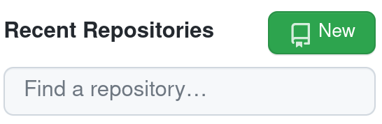
GitHub
Go to: https://github.com
Sign in (or create an account)
Click on “Create New Repository” or just “New”

Slide 33
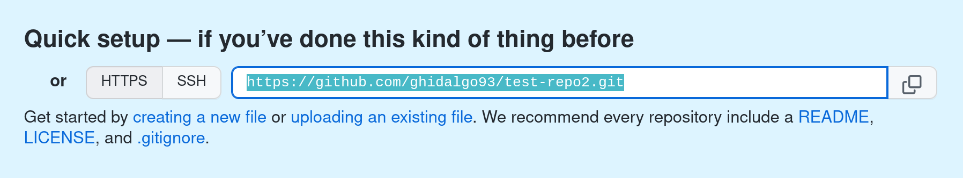
Create Repo in GitHub
Create a new repo
Call it whatever you would like
Ignore directions for you, just copy the link
e.g. https://github.com/<user>/test-repo.git

Slide 34
Git Remote
Git remote tells you which remote repositories you have linked to your local project.
$ git remote # should return nothing
To link our remote repository (accepts 2 values):
$ git remote add <name of remote repo> <url>
$ git remote add origin https://github.com/<user>/test-repo.git
View remote again
$ git remote
$ git remote -v # view url as well

Slide 35
Git Push
Sync up local code with remote GitHub repo!
Git push uploads a local repositories content to a remote repository. Pushing is how you transfer commits from your local repository to a remote repo
$ git push <name of remote repo> <branch> # optional -u flag
$ git push origin main -u
Local
Remote
Working Directory
Staging Area
Repository
commit #1234
“initial commit”
Repository
git push

Slide 36
GitHub
Go back to GitHub and refresh your page
should see the files we have added (and not the ones we’ve ignored)
Some cool features!
look at our commits
directly edit/commit in the browser
Let’s do that! Let’s fix the typo and commit it
But now our remote repo is one commit ahead of our local one…

Slide 37
Git Fetch & Merge
Git fetch retrieves the changes from the remote repo
$ git fetch
Git merge combines two branches
$ git merge origin/main
But, there’s an easier way!

Slide 38
Git Pull
Git pull combines the fetch and merge commands
**Must have clear working directory!**
$ git pull origin main
$ git pull # because we used the -u flag earlier!

Slide 39
Git Clone
Git clone makes a clone or copy of a remote repo at in a new directory, at another location.
$ git clone <url> <optional new name>
Next, let’s clone the lesson’s repo to a new space (yes, this lesson was made with Git and hosted by GitHub!) and get the 2 other files for our project
$ cd /projects/$USER
$ git clone https://github.com/ResearchComputing/HPC_software_dev_course
$ cd HPC_software_dev_course
$ cp git/files/lb_cmd_file path/to/your/git-tutorial/repo
$ cp git/files/run_hello.sh path/to/your/git-tutorial/repo

Slide 40
Update your project! (practice)
Once you have all 3 files in your local git-tutorial repo, go ahead and Add + Commit them
Then push up to your GitHub repo and ensure they are there!

Slide 41
Collaborate

Slide 42
Git Branch (alternate universe!)
Allows you to collaborate with other team/lab members without getting in each other's way
Or just do testing without messing up your working files!
Jane’s Branch
Main
Jim’s Branch

Slide 43
Git Branch
Git branch will allow you to create and list new branches
$ git branch # list branches
Create new branch
$ git branch coolbranch
$ git branch # still on main branch!
Delete branch
$ git branch -d <branch> # safer
$ git branch -D <branch> # forces

Slide 44
Git Checkout
Git checkout moves us to branch
$ git checkout coolbranch
Try to change some code, add, and commit it to new branch!
Switch back to main branch
$ git checkout main
The code disappears! Can go back to it with
$ git checkout coolbranch
Create new branch and checkout into it (shortcut)
$ git checkout -b <branch>

Slide 45
Pull Request
Pull requests let you tell others about changes you've pushed to a branch in a repository on GitHub.
Once a pull request is opened, you can:
discuss and review the potential changes with collaborators
add follow-up commits
all before your changes are merged into the base branch
Let’s try it, on your new branch make a change, add, commit:
$ git push origin <branch> -u

Slide 46
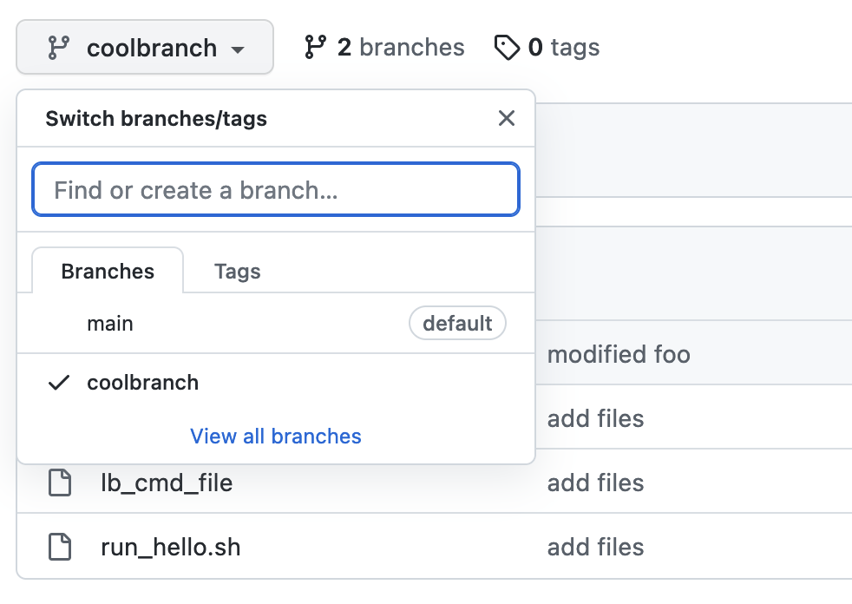
Pull Request
Go back to the GitHub Repo
Choose the new branch (coolbranch)!
Should be able to see new changes

Slide 47
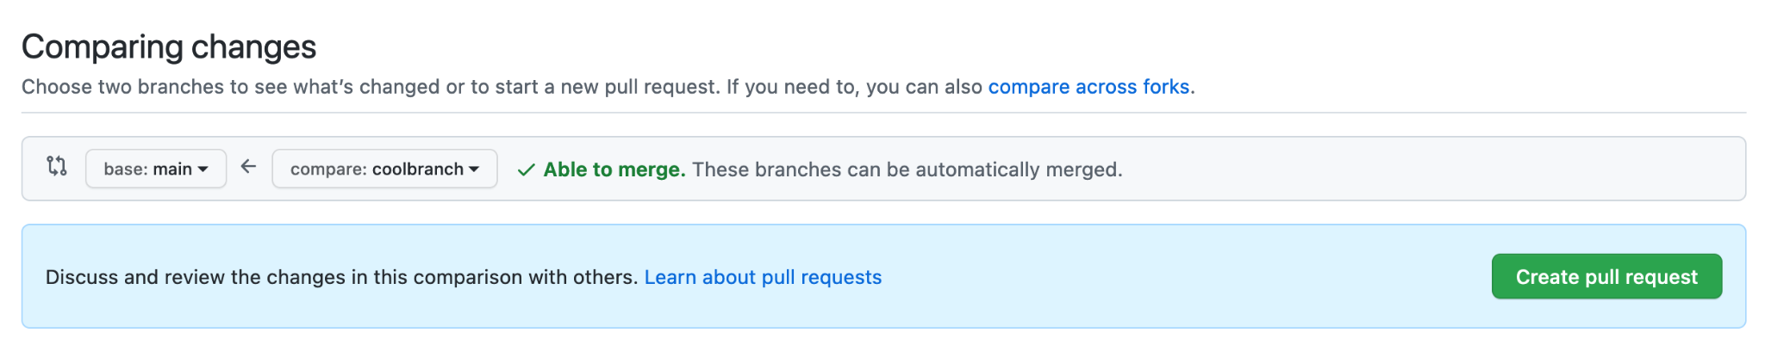
Pull Request
Figure out which branch you want to pull in/merge
Create pull request
You can see all of the changes below

Slide 48
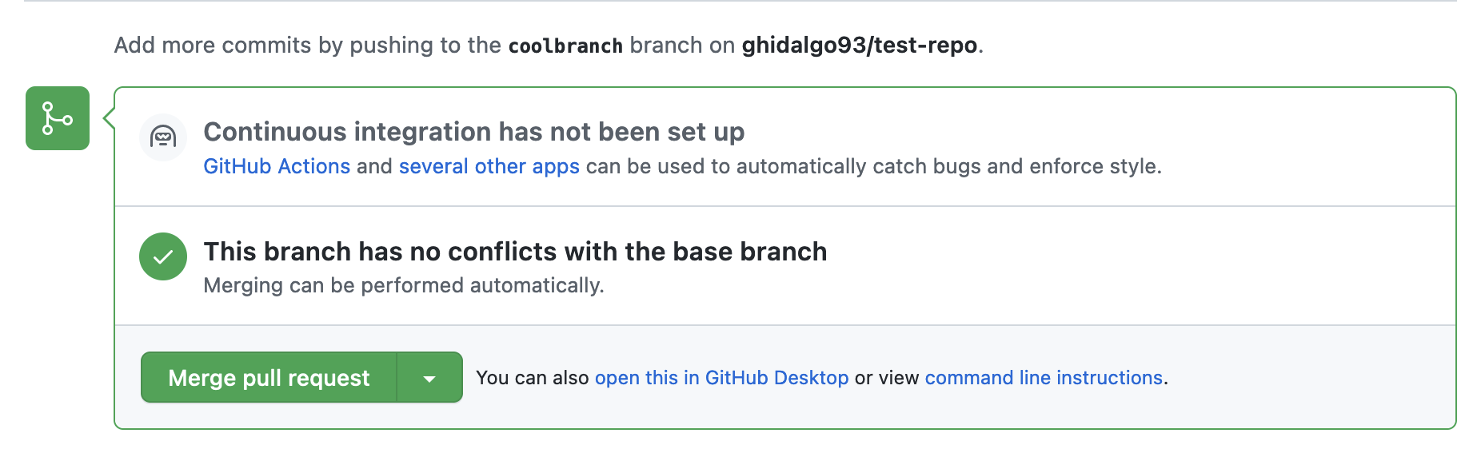
Pull Request
If there are no merge conflicts we can merge automagically!
You can accept the pull request on your own repos

Slide 49
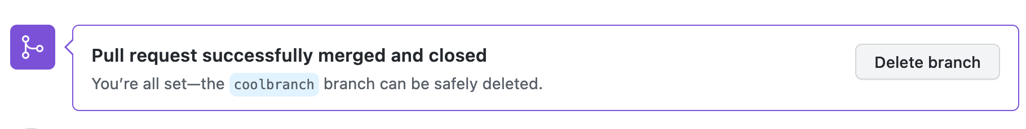
Pull Request
Make sure to clean up your old branches!
keeps your project clean for others
Deleting this branch in GitHub only removed it in the remote repo, so you will still have a local copy

Slide 50
Advanced

Slide 51
Fork
A GitHub fork allows you to copy over an existing open source project into your GitHub account
Maintains link to original repo where you can fetch updates
The original is called the “upstream” repository
Practice: https://github.com/ghidalgo93/git-PR-practice
Once you have a local copy (fork, then clone it locally)
Make any changes (LOTS of spelling mistakes in github_wiki.txt)
Commit back up to your own GitHub repo
Submit a pull request to my repo!

Slide 52
Merge Conflicts
Conflict occurs when you try to merge 2 different branches that modify the same lines
Let’s make a conflict!
Commit from 2 branches (main and coolbranch) with changes to a file on the same line
From main:
$ git merge coolbranch
You’ll get an error that the merge failed

Slide 53
Merge Conflicts
Go into the file that caused the commit to fail
or view those with: $ git diff
Remove whichever lines are not needed
or keep both one after the other
Then rerun your commit (called a merge commit)

Slide 54
Review: Learning Goals
Understand basics of version control
Differences between Git, GitHub
Basic Git fluency
How to collaborate on a project with Git

Slide 55
Help! I’m stuck, where do I go?
Documentation: curc.readthedocs.io/
Trainings with Center for Research Data and Digital Scholarship (CRDDS): https://www.colorado.edu/crdds/
Helpdesk: rc-help@colorado.edu

Slide 56
Questions

Slide 57
Survey and feedback
http://tinyurl.com/curc-survey18

